Slide 1
Capstone Project – Hotel Analysis

Slide 2
INTRODUCTION
Introduction:
Understanding and optimizing hotel operations requires comprehensive analysis of various aspects of reservations, guest demographics, booking statuses, and historical behaviors. Within this framework, the Room_Details table serves as a fundamental repository, providing crucial insights into room reservation dynamics and booking modifications.
The Room_Details table is intricately linked with the Booking_Details table through a unique booking identifier, forming a pivotal connection within the database schema. This linkage allows for a seamless integration of data related to room reservations and booking specifics.
Within the Room_Details table, key information such as the type of room initially reserved, the eventually assigned room type, and the number of changes made to the booking are meticulously documented. These details offer invaluable insights into the dynamic nature of room allocation and the evolution of reservations over time.
Moreover, alongside the Reservation_Status table, which captures the progression of reservations and their final outcomes, the Room_Details table plays a crucial role in deciphering patterns and trends within the hotel's booking landscape. By analyzing changes in room assignments and reservation statuses, hotel management can make informed decisions to enhance operational efficiency and guest satisfaction.
In conjunction with other tables such as Booking_Details, Guest_Info, Meal_And_Stay_Details, and Booking_Source_and_History, the Room_Details table forms an integrated ecosystem of data, enabling comprehensive analysis of hotel operations from various perspectives. Together, these tables provide a holistic understanding of reservation dynamics, guest demographics, booking sources, and historical behaviors, empowering hotel management to optimize resource allocation, enhance guest experiences, and drive business growth.

Slide 3
descriptions of various tables in a database RELATED TO HOTEL ANALYSIS
Room_Details: Stores information about room reservations and changes made to them, including initial and eventually assigned room types, and the number of changes made to the booking.
Reservation_Status: Records the status of reservations over time, capturing the last status and the date it was recorded. Useful for tracking reservation progression and outcomes.
Booking_Details: Contains essential details of hotel reservations, such as unique booking identifier, hotel type, cancellation status, lead time, arrival date details, and number of weekend and weekday nights stayed.
Guest_Info: Provides insights into guests associated with each booking, recording the number of adults, children, and babies accompanying the booking.
Meal_And_Stay_Details: Complements booking information with meal-related and stay-related attributes, including meal type, Average Daily Rate (ADR), car parking requirements, and total count of special guest requests.
Booking_Source_and_History: Crucial for understanding booking sources and guest historical behavior, containing information like market segment, distribution channel, repeated visitor status, previous booking history, deposit type, booking agent/company IDs, waiting list duration, and customer type.

Slide 4
Hotel Analysis using excel and sql queries
Retrieve room reservation data from the Room_Details table, including initial and assigned room types, and the number of changes made to bookings.
Analyze reservation statuses over time by querying the Reservation_Status table to track reservation progression and outcomes.
Extract essential details of hotel reservations, such as unique booking identifiers, hotel types, cancellation statuses, lead times, and arrival date details, from the Booking_Details table.
Gain insights into guest demographics by querying the Guest_Info table to record the number of adults, children, and babies accompanying each booking.
Analyze meal-related and stay-related attributes, such as meal types, Average Daily Rate (ADR), car parking requirements, and special guest requests, using data from the Meal_And_Stay_Details table.
Understand booking sources and guest historical behavior by querying the Booking_Source_and_History table, which contains information about market segments, distribution channels, repeated visitor statuses, previous booking histories, deposit types, booking agents/companies, waiting list durations, and customer types.
By combining Excel for data analysis and visualization with SQL queries for database extraction and analysis, hotel managers can gain comprehensive insights into various aspects of their operations. This integrated approach enables informed decision-making, facilitates performance monitoring, and supports strategic planning to drive success in the competitive hospitality industry.

Slide 5
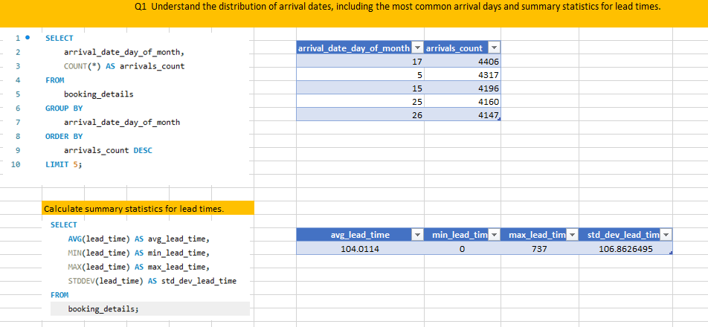
Problem Statement 1. Analysis
Understand the distribution of arrival dates, including the most common arrival days and summary statistics for lead times.

Slide 6
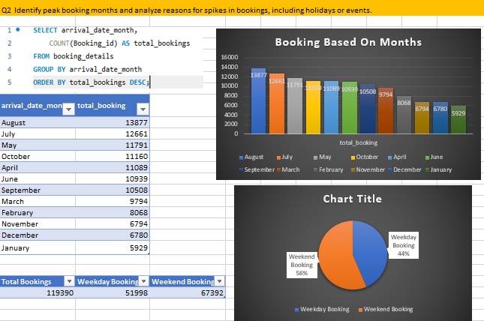
Peak booking month analysis
we can effectively identify peak booking months and analyze the reasons for spikes in bookings, including holidays or events, using a combination of Excel for data analysis and SQL queries for data extraction and manipulation.

Slide 7
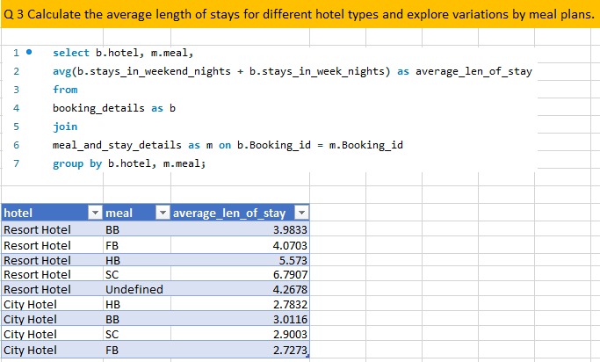
Analysis by meal and average length of stays
By grouping the data by hotel and meal, you can observe the average length of stays for different hotel types with variations based on meal plans.

Slide 8
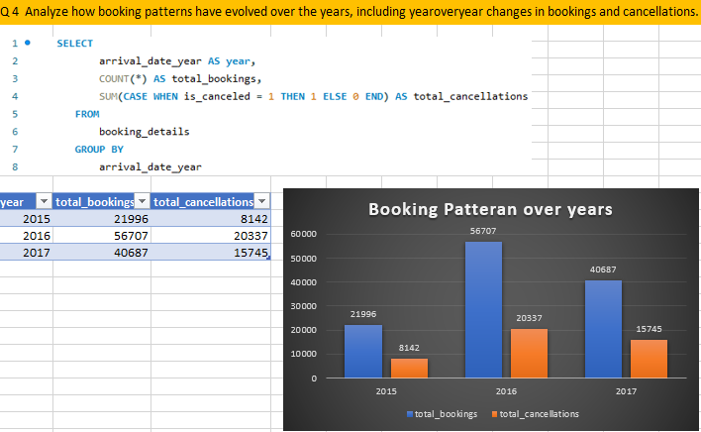
Booking patterns analysis
By following these steps, we can effectively analyze how booking patterns have evolved over the years and understand year-over-year changes in bookings and cancellations using SQL queries for data extraction and Excel for data analysis and visualization.

Slide 9
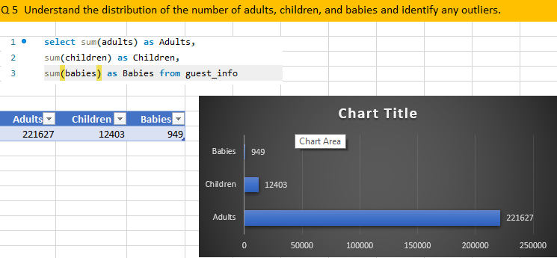
Distribution analysis
From chart be can see that number of visitor Adults are much more higher then children and babies. so be can say that majority of visitors are Adults

Slide 10
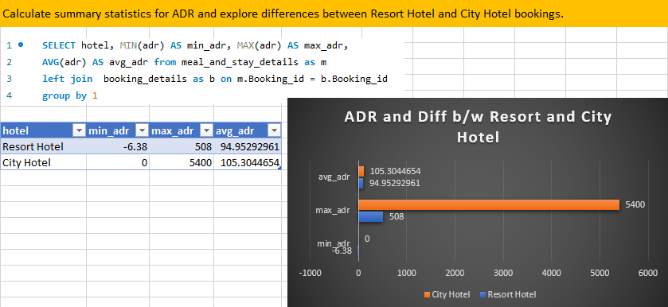
Summary statistics
To calculate summary statistics for ADR (Average Daily Rate) using SQL, we typically use aggregate functions like AVG, MIN, MAX, and COUNT

Slide 11
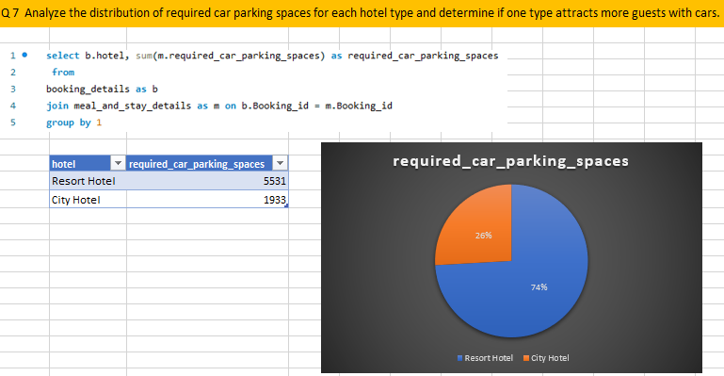
Analysis for car parking space
As be can one type attracts more guests with cars is Resort Hotel . it consist of more number of required car spaces as compared to City Hotel. as shown in Pie chart City Hotel = 26 , Resort Hotel = 74%

Slide 12
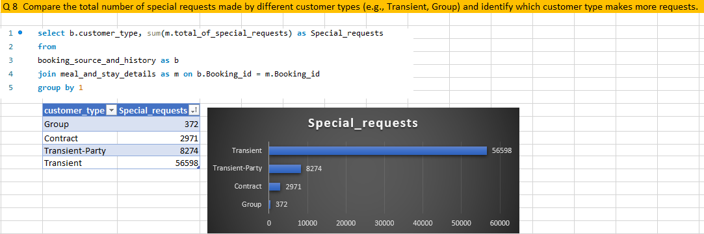
Analysis of special requests
As from we can see from bar graph Transient customer type make more special request as compare to group, contract, transient_party

Slide 13
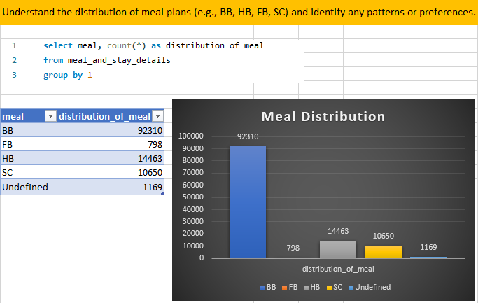
Distribution of meal
As we can see in column graph there is more preferences is given to BB as compare to FB,HB,SC .

Slide 14
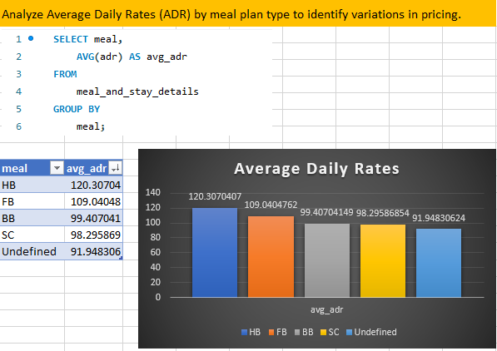
ADR Analysis
So as pr table data and chart
be see that average daily rates for each meal where HB, FB have more then 100 and other like BB,SC are less expensive

Slide 15
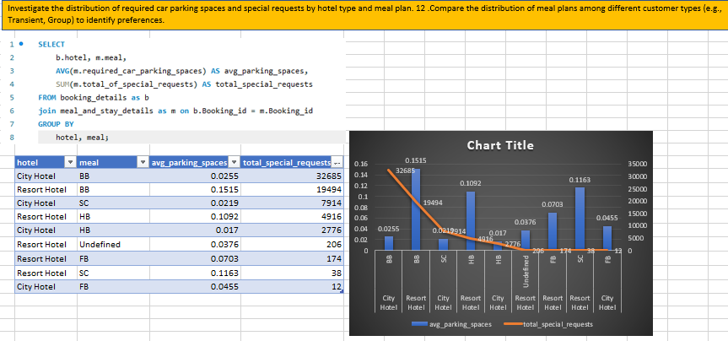
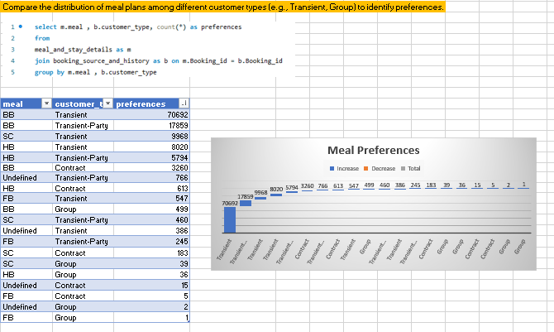
Hotel , meal preferences
now be can see the distribution of required car parking spaces and special requests by hotel type and meal plan

Slide 16
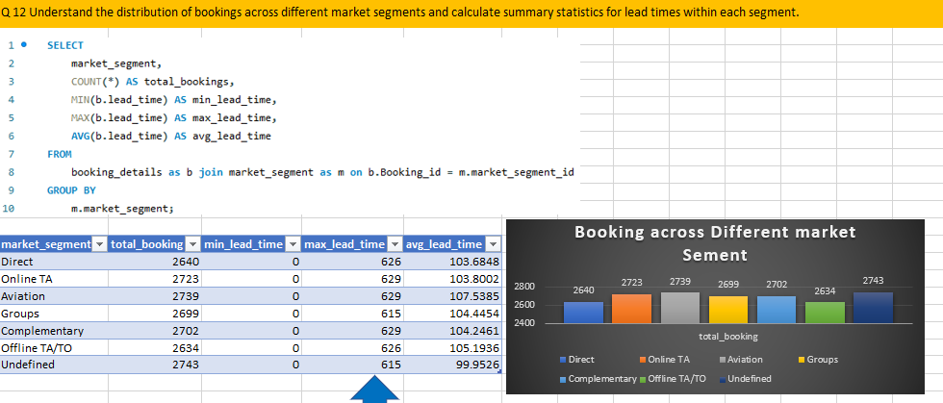
Booking in diff market segment
summary statistics for lead times within each segment

Slide 17
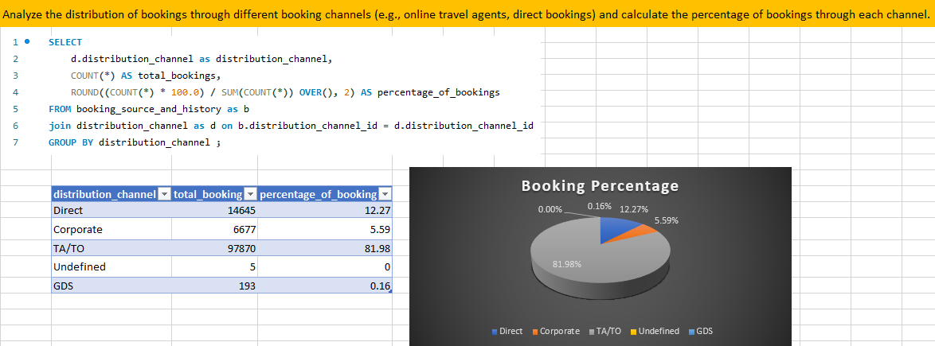
Analysis of booking through channels

Slide 18
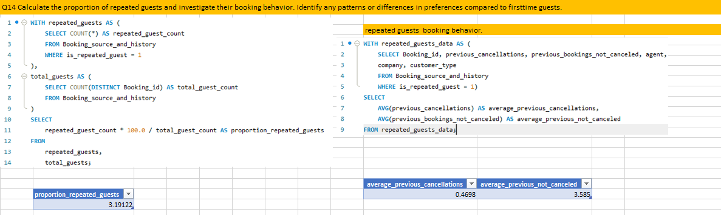
Booking behavior
Proportion of repeated guest, avg cancellation, avg previous not cancelled

Slide 19
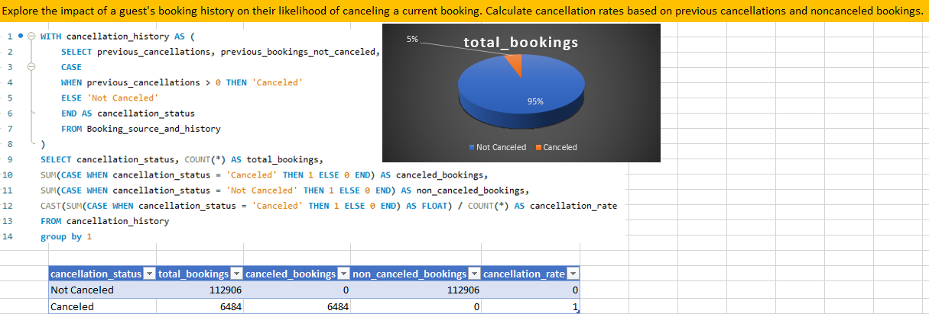
Analysis of cancelling and not canceled booking

Slide 20
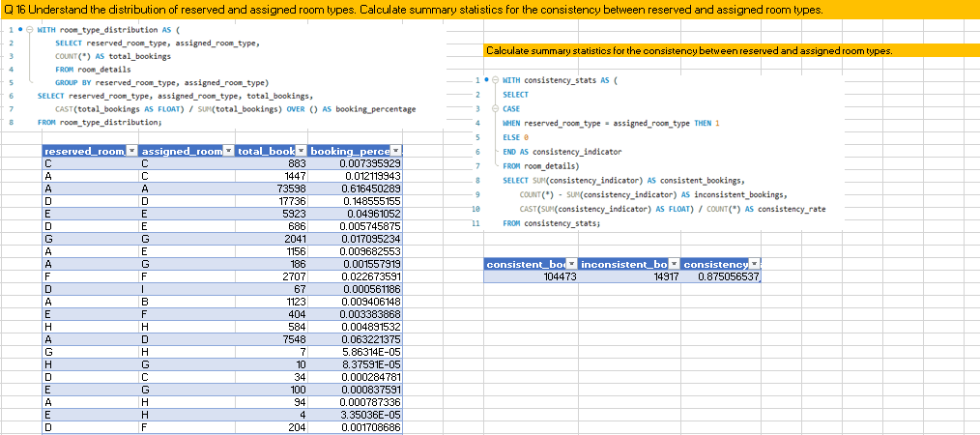
Analysis of assigned , reserved room type

Slide 21
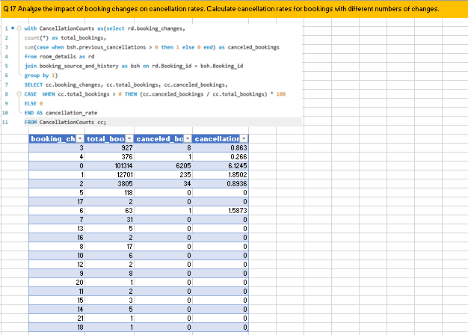
Impact of booking changes on cancellation rate
As you can see the impact of booking changes on cancellation rates. cancellation rates for bookings with different numbers of changes. cancellation rate is higher when booking changes is low

Slide 22
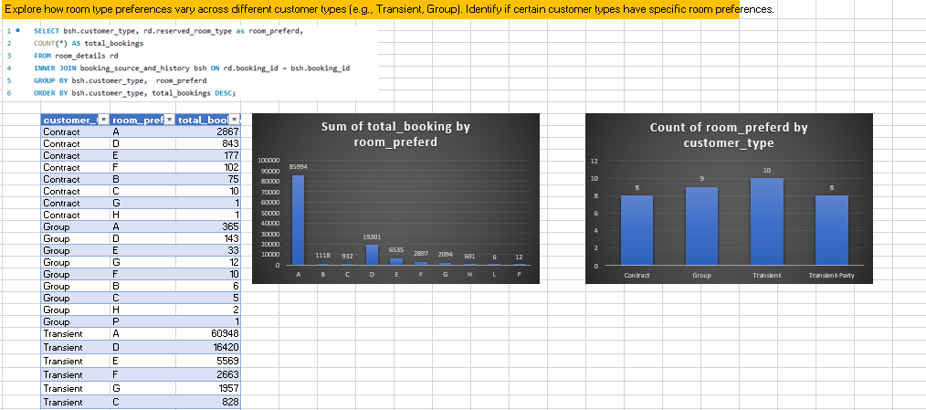
Booking by room preferred, customer type

Slide 23
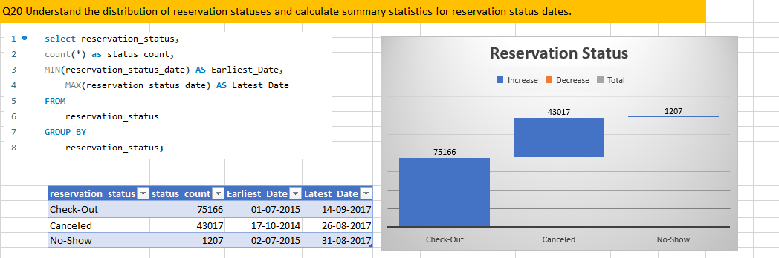
Analysis of reservation status

Slide 24
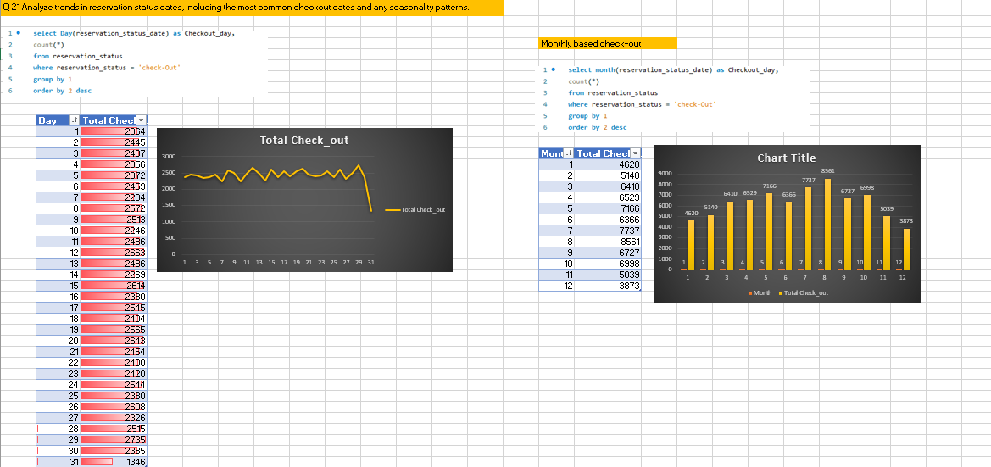
Trend in reservation status

Slide 25
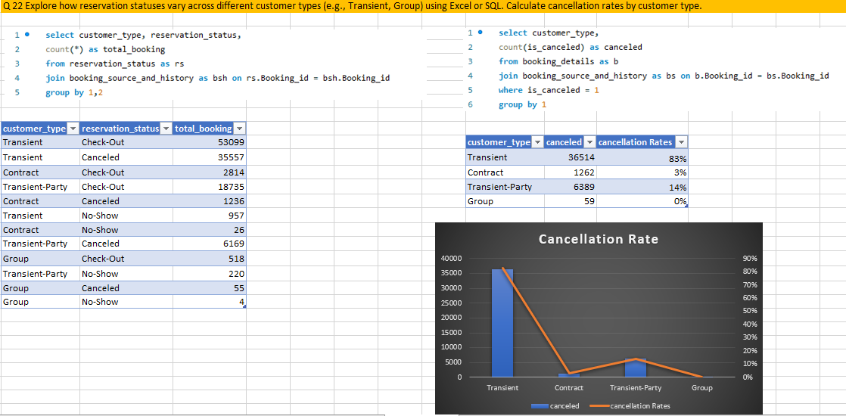
Reservation status across diff customer type

Slide 26
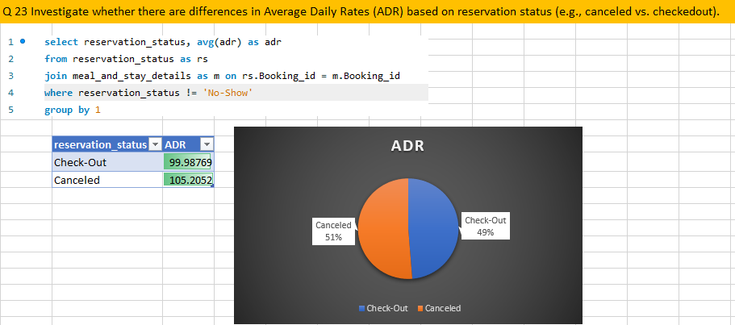
ADR BASED ON RESERVATION STATUS

Slide 27
CAPSTONE PROJECT- ANALYSIS USING POWER BI

Slide 28
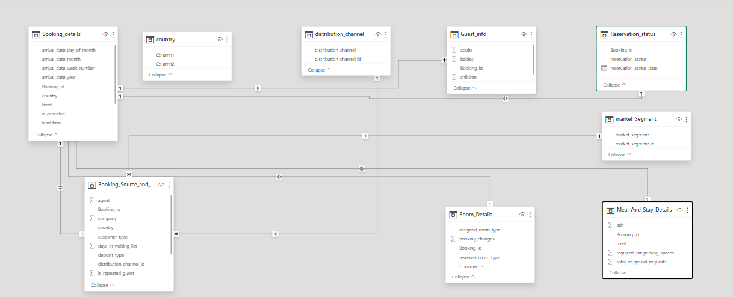
ER DIAGRAM

Slide 29
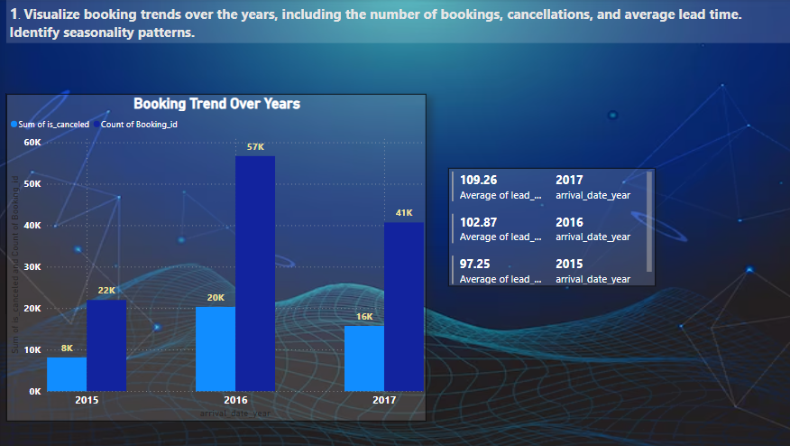
TREND OVER YEAR(BOOKING,CANCELLATIONS)
By following these steps and visualizing the booking trends over the years using a bar chart, we can effectively identify seasonality patterns and gain insights into the overall booking behavior and cancellation trends.

Slide 30
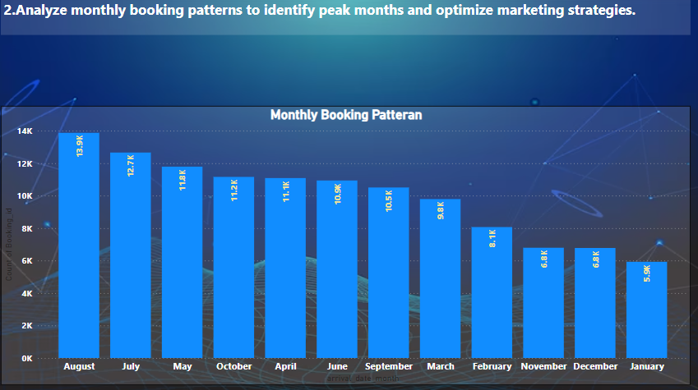
MONTHLY BOOKING PATTERNS
The peak months are august, July,may where is more booking are done on monthly basies

Slide 31
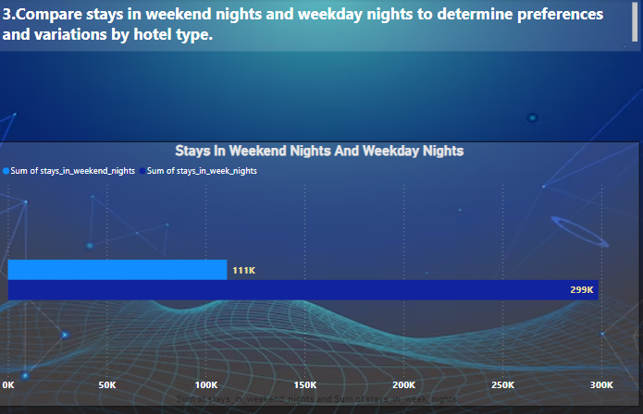
WEEKEND, WEEKDAY NIGHTS STAYS
As be can see in weeknights people stay more as compare to the weekend nights.

Slide 32
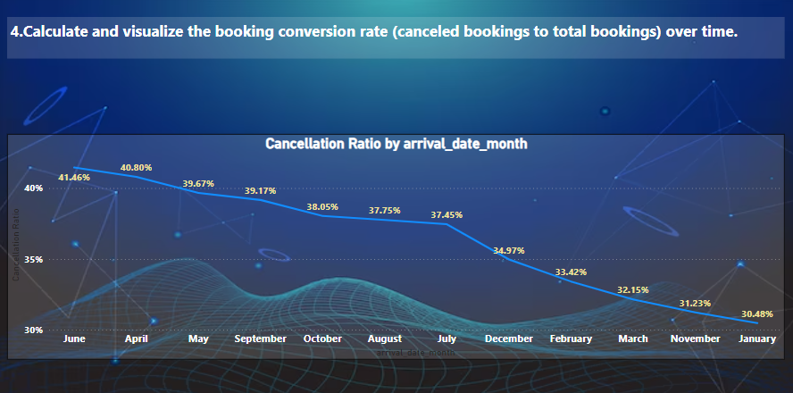
CANCELLATION RATIO
Here be can see line graph based on cancellation ration based on months. Cancellation is more in June, April, may,sept

Slide 33
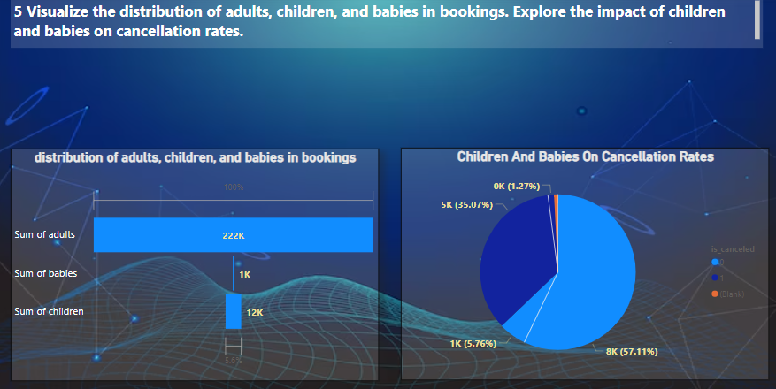
Distribution of guests

Slide 34
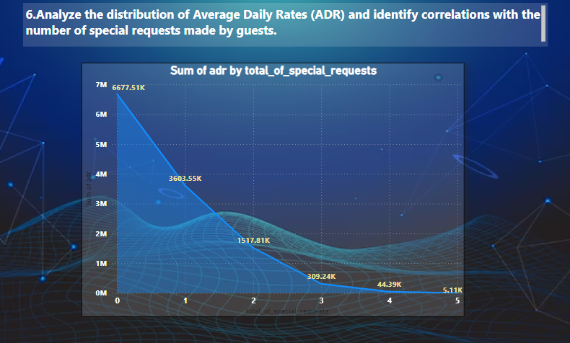
Distribution of adr

Slide 35
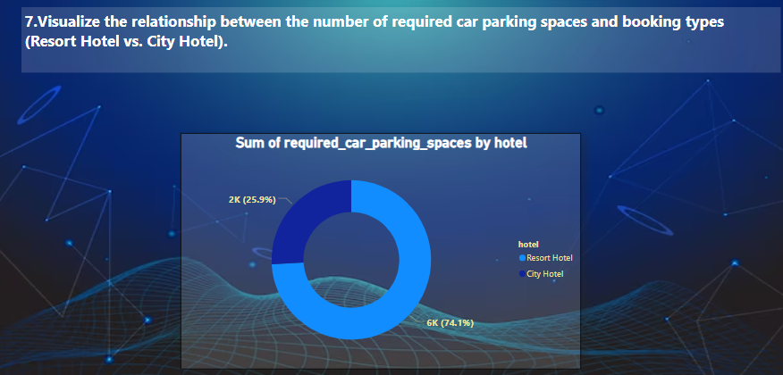
Resort hotel vs city hotel
The resort hotel have more car parking space as compare to the city hotel. Resort Hotel = 74.1% City Hotel = 25.9%

Slide 36
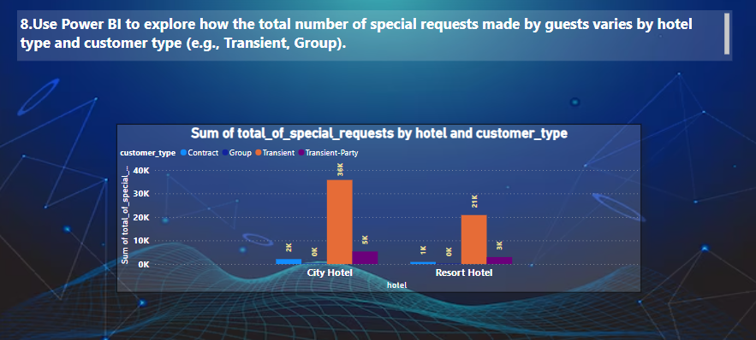
Request made by guests varies by hotel
Special request made by diff customer type based on hotel.

Slide 37
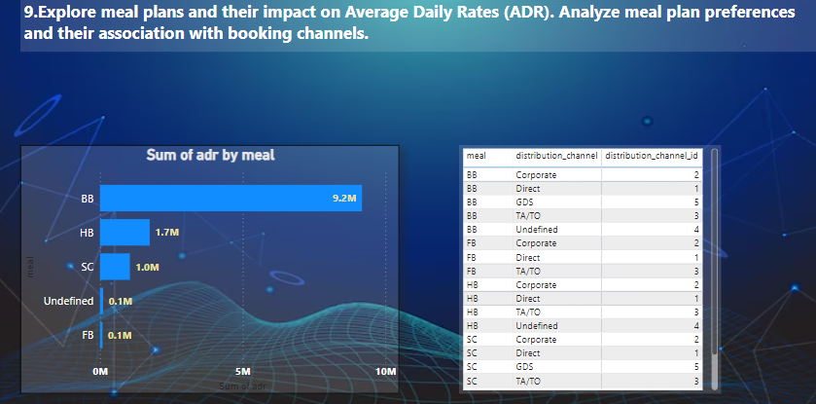
MEAL PLAN AND THEIR IMPACT ON ADR

Slide 38
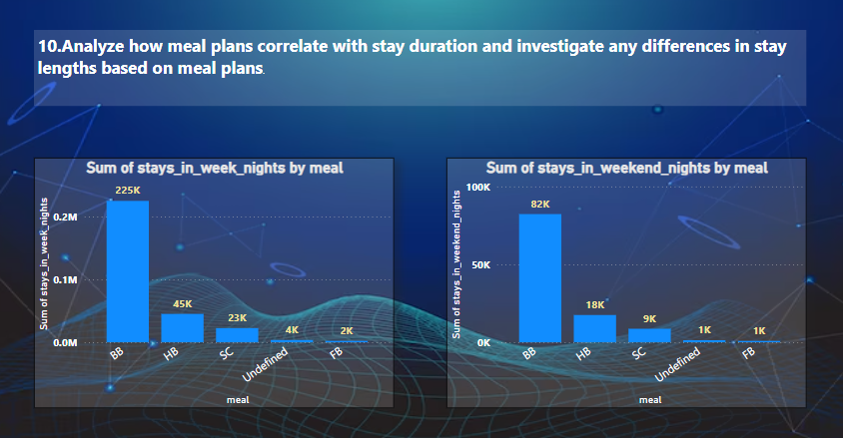
Meal plan correlate with stay duration
Stay lengths based on meal plans shows that guests prefer week_nights meal as compare to the weekend_nights

Slide 39
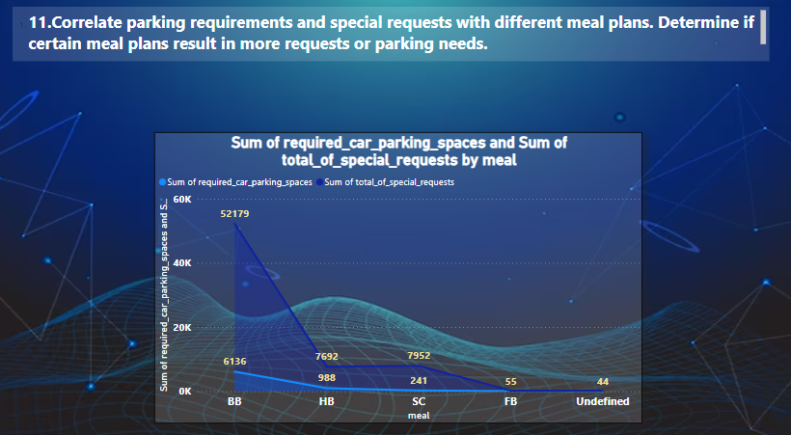
Parking req and special requests with diff meal plans
So here be can see the co relation between car parking spaces and special requests

Slide 40
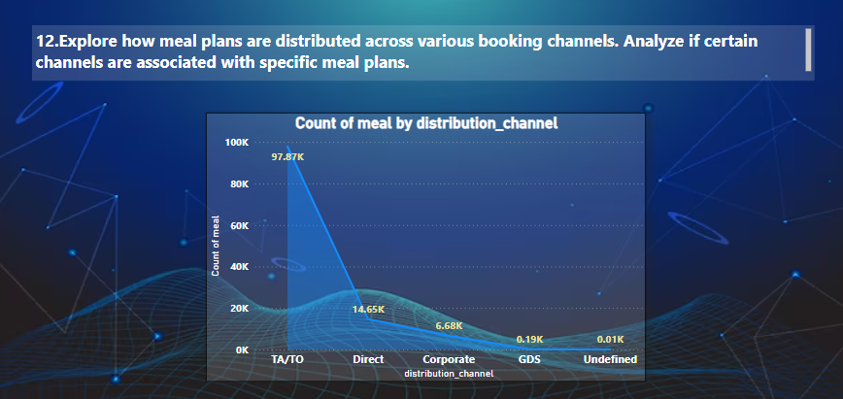
MEAL PLANS DISTRIBUTED ACROSS VARIOUS BOOKING CHANNELS
Meal distribution is more in TA/TO as compare to the other channels

Slide 41
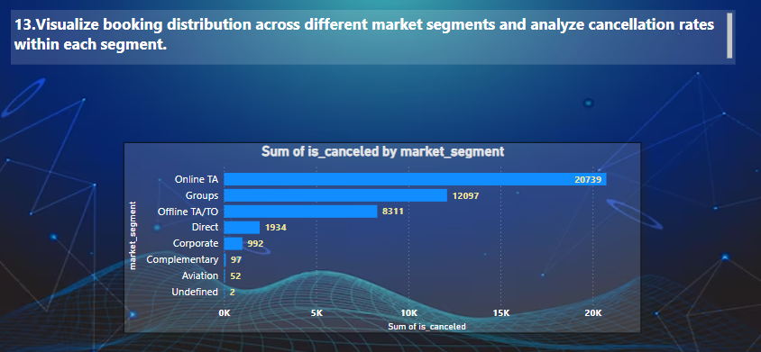
BOOKING DISTRIBUTION ACROSS MARKET SEGMENTS
Canceled Booking is done more in online TA plateform as be can see and les is done on undefined

Slide 42
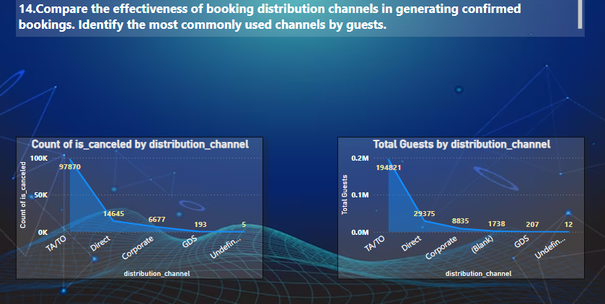
Analysis of booking distribution
Here be have compared the both the line chart as you can see based on channel

Slide 43
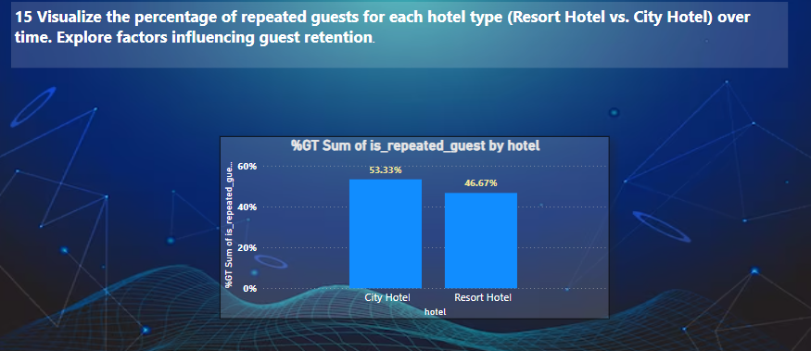
RESORT HOTEL VS CITY HOTEL
As be can see repeated guest came more to city hotel that is 53.33% and Resort hotel it is 46.67% which is less to city hotel

Slide 44
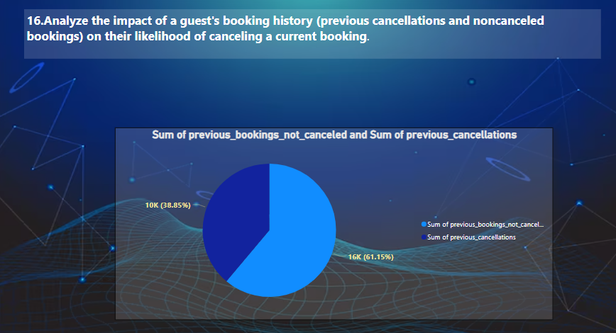
Previous cancel and not canceled booking
From pie chart be can see that previous booking not canceled is more compare to previous cancellation

Slide 45
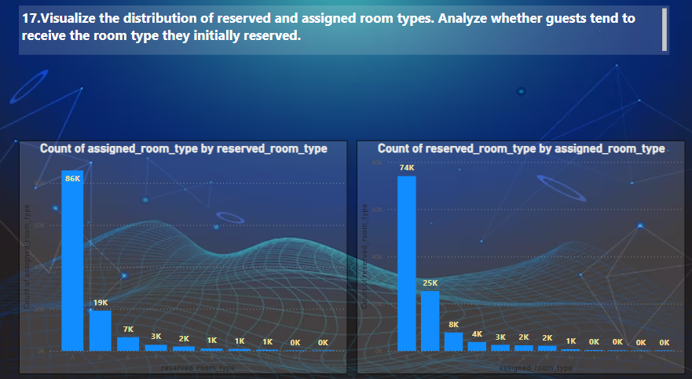
Distribution of reserved and assigned room types

Slide 46
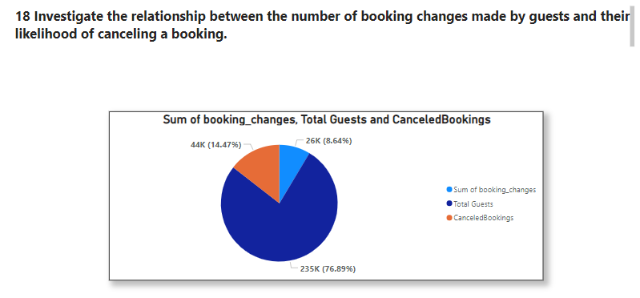
BOOKING CHANGES AND canceling a booking

Slide 47
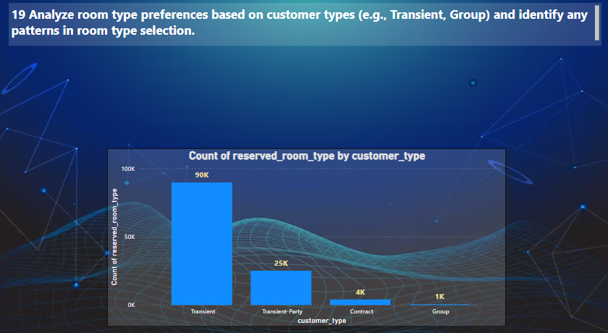
Room preference based on customer type
Customer that are Transient give more room preference and group are the least one

Slide 48
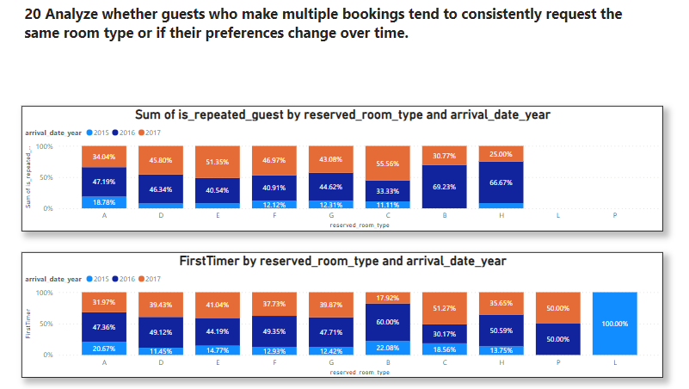
Guest analysis
Charts based on first timer and repeated customer

Slide 49
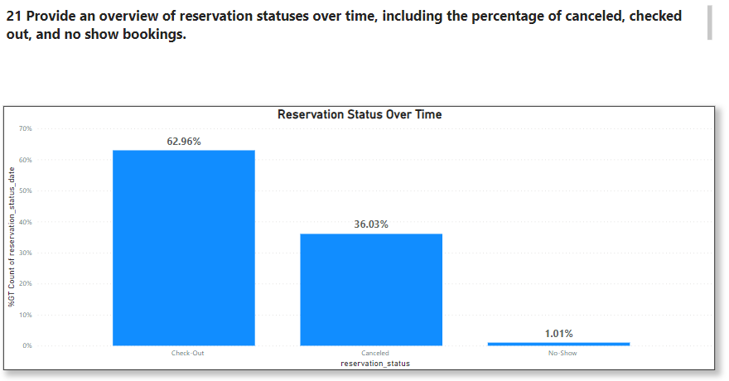
Reservation status over time

Slide 50
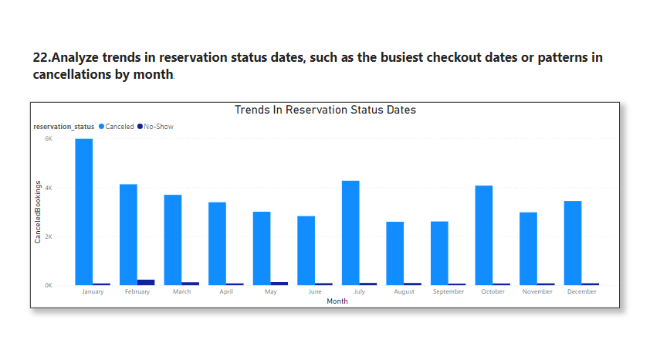
Analysis on reservation status

Slide 51
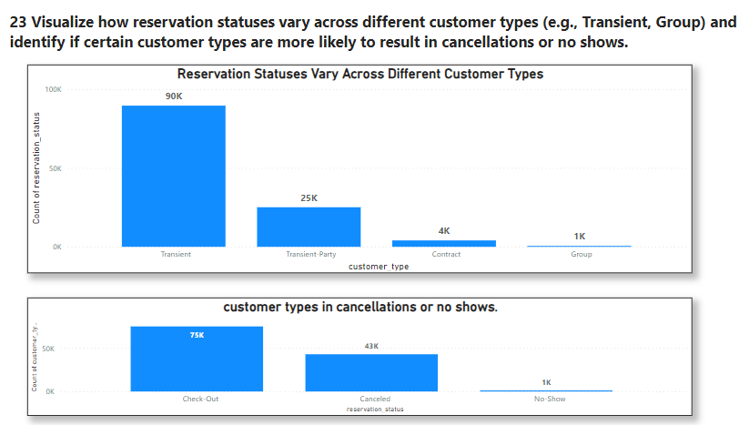
Analysis on reservation status

Slide 52
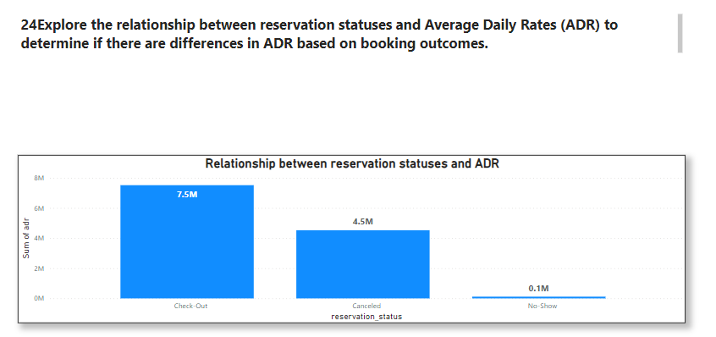
Analysis on reservation status
Check out have more ADR as compare to reservation status and no show as be can see in col chart

Slide 53
THANK YOU

